Slide 1

Functions

Slide 2

Why??
Convenient way to divide your code into useful blocks
Reuse the code
Readable

Slide 3
Types of Function
Built-in function
User Defined function

Slide 4

How to define a function
Name of function
Parameters of the function
Keyword to define the function
Body of function
Return result

Slide 5

How call a function
To call a function

Slide 6
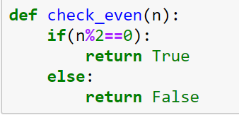
Write a function to calculate number is even or not even.
Return True if even else false

Slide 7
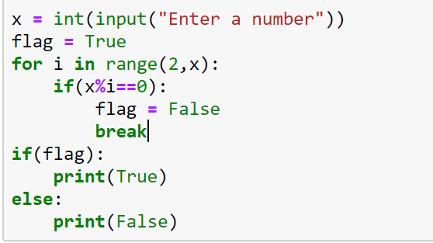
What this code is doing

Slide 8
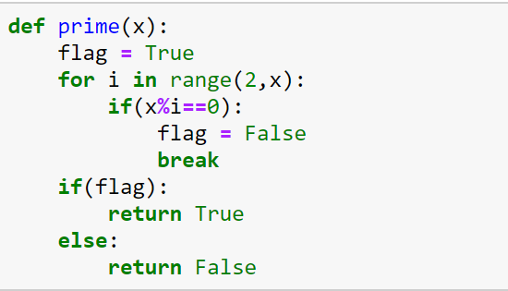
Can we right function to check number is prime or not

Slide 9
More on Function Arguments
Required arguments
Default arguments
Keyword arguments
Variable number of arguments

Slide 10
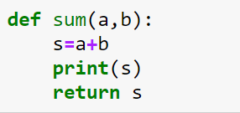
Required argument
**Open Acadly and give the answer?

Slide 11
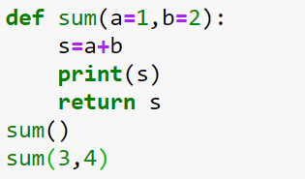
Default Argument

Slide 12
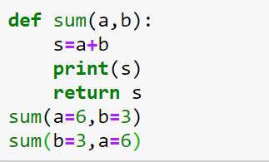
Keyword argument

Slide 13
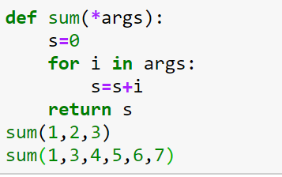
Variable number of argument

